Slide 1
Microprocessors and Assembly Language Lecture 19 Hamed Farbeh farbeh@aut.ac.ir Spring 2023

Slide 2
Copyright Notice
Parts (text & figures) of this lecture are adopted from:
Arm Assembly Language Programming and Architecture, Volume 1, 1st edition, Muhammad Ali Mazidi, Sarmad Naimi, and Sepehr Naimi, MicroDigitalEd, 2013.

Slide 3

Arithmetic and Logic Instructions and Programs

Slide 4
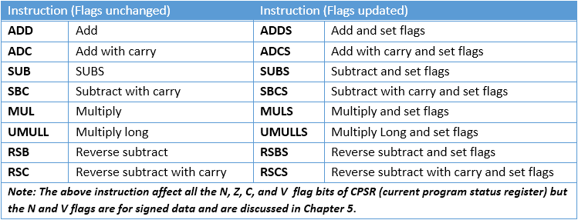
Arith. Instr. and Flag Bits for Unsigned Data
No increment instr. In ARM
Use the available ADD instr.

Slide 5
ADD and ADC
Add
ADD Rd, Rn, Op2 ; Rd = Rn + Op2
LDR R0, =0x10; R0 = 0x10
ADD R1, R0, 0x5; R1 = 0x15
Add with carry
ADC Rd, Rn, Op2; Rd = Rn + Op2 + Carry

Slide 6
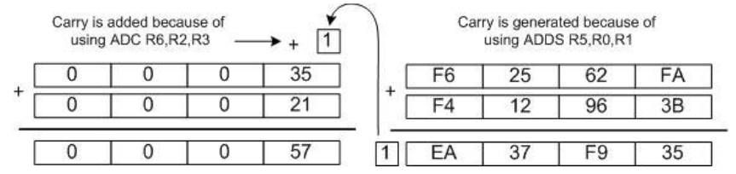
Multiword ADD
Add 0x35F62562FA to 0x21F412963B
LDR R0, =0xF62562FA; R0 = 0xF62562FA
LDR R1, =0xF412963B; R1 = 0xF412963B
MOV R2, #0x35; R2 = 0x35
MOV R3, #0x21; R3 = 0x21
ADDS R5, R1, R0; R5 = 0xF62562FA + 0xF412963B ; now C = 1
ADC R6, R2, R3; R6 = R2 + R3 + C; = 0x35 + 21 + 1 = 0x57

Slide 7
SUB and SBC
Subtract
ADD Rd, Rn, Op2; Rd = Rn + Op2
LDR R0, =0x10; R0 = 0x10
SUB R1, R0, 0x5; R1 = 0x0B
Subtract with carry
SBC Rd, Rn, Op2
; Rd = Rn - Op2 - !Carry
; Subtracts 1 from the result if carry is not set

Slide 8
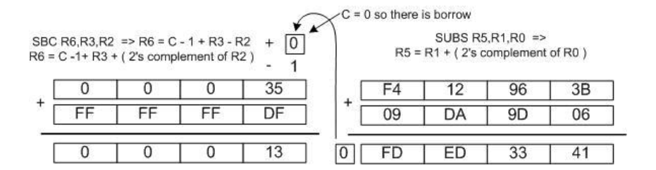
Multiword SUB
Sub 0x21F62562FA from 0x35F412963B
LDR R0, =0xF62562FA; R0 = 0xF62562FA ; notice the syntax for LDR
LDR R1, =0xF412963B; R1 = 0xF412963B
MOV R2, #0x21; R2 = 0x21
MOV R3, #0x35; R3 = 0x35
SUBS R5, R1, R0; R5 = R1 – R0; = 0xF412963B – 0xF62562FA, and C = 0
SBC R6, R3, R2; R6 = R3 – R2 – 1 + C; = 0x35 – 0x21 – 1 + 0 = 0x13

Slide 9
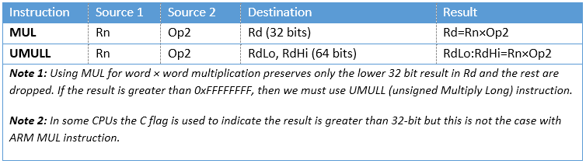
Multiplication and Division of Unsigned Numbers
Not all CPUs have instr. for mult. and div.
All the ARM processors have mult., but not all have div.
ARM Cortex-M3 and M4 have both mult. and div.
MUL: Regular multiplication
MULL: long multiplication

Slide 10
Multiplication of Unsigned Numbers
MUL: Regular multiplication
MULL: long multiplication
LDR R1, =100000; R1=100,000
LDR R2, =150000; R2=150,000
MUL R3, R2, R1; R3 is not 15,000,000,000; it cannot fit in 32 bits.
LDR R1, =0x54000000; R1 = 0x54000000
LDR R2, =0x10000002; R2 = 0x10000002
UMULL R3, R4, R2, R1; 0x54000000 × 0x10000002 = 0x054000000A8000000;
; R3 = 0xA8000000, the lower 32 bits R4 = 0x05400000, the higher 32 bits

Slide 11
Multiplication of Unsigned Numbers
Multiply and Accumulate Instructions in ARM
MLA Rd, Rm, Rs, Rn ; Rd = Rm × Rs + Rn MOV R1, #100; R1 = 100
MOV R2, #5; R2 = 5
MOV R3, #40; R3 = 40
MLA R4, R1, R2, R3; R4 = R1 × R2 + R3 = 100 × 5 + 40 = 540
To accumulate the products of the multiplication
MLA R3, R1, R2, R3; R3 = R1 × R2 + R3 or R3 += R1 × R2
UMLAL: unsigned multiply and accumulate long
UMLAL RdLo, RdHi, Rn, Op2; RdHi:RdLo = Rn × Op2 + RdHi:RdLo

Slide 12
Bitwise operations
Bitwise AND
AND Rd, Rn, Op2 AND R0, R1, #0xF0; R0 = R1 & 0xF0
Bitwise OR
ORR Rd, Rn, Op2 ORR R0, R1, #0x10; R0 = R1 | 0x10
Bitwise XOR
EOR Rd, Rn, Op2 EOR R0, R1, #0xFF; R0 = R1 ^ 0xFF (Same as a bitwise NOT)
Bitwise NOT
MVN Rd, Op2 MVN R1, R1; R1 != R1

Slide 13

Rotate and Barrel Shifter
LSR: Logical shift right
MOV R0, #0x9A; R0 = 0x9A
MOVS R1, R0, LSR #3
; shift right R0 3 times, then store the result in R1 MOV R0, #0x9A
MOV R2, #0x03
MOVS R1, R0, LSR R2
; shift right R0 R2 times; and move the result to R1

Slide 14


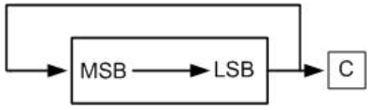
Rotate and Barrel Shifter
LSL: Logical shift left
MOV R1, R1, LSL R2
ROR: Rotate right
MOVS R1, R1, ROR #1
MOVS R1, R1, ROR R0

Slide 15

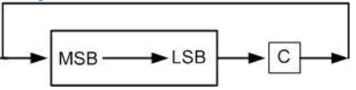
Rotate and Barrel Shifter
NO ROL: Rotate left
Use ROR for rotating left
n-bit ROL ⬄ (32 - n)-bit ROR
Take care of carry
RRX: Rotate right through carry
Takes no arguments
MOVS R2, R2, RRX; Rotate 1 bit

Slide 16
Rotating Immediate Arguments
MOV Instruction
MOV R0, #0xFF, #2; R0 = 0xFF is rotated right 2 times. R0 = 0xC000003F
MOV R0, #0xFF, #12; R0 = 0xFF is rotated right 12 times. R0 = 0x0FF00000
MOV R0, #0xFF, #28; R0 = 0xFF is rotated right 28 times. R0 = 0x00000FF0
BUT, Rotate field (bit₁₁-bit₈) is 4-bit

Slide 17
Rotating Immediate Arguments
Shift instruction
MOV R0, R2, LSL #8 ⬄ LSL R0, R2, #8
ASR: Arithmetic Shift right
ASR Rd, Rm, Rn
ASRS Rd, Rm, Rn
LSL: Logical Shift Left
LSL Rd, Rm, Rn
…

Slide 18
Rotating Immediate Arguments
The multiplication instruction can take 32 clock cycles in some systems
Shifting and adding could be used in some cases instead
MUL R0, R0, #9; R0 *= 9 ADD R0, R0, R0, LSL #3; R0 = R0 + R0*8

Slide 19
Reverse Subtraction
SUB: Rd = Rn – Op2
You can only shift or use an immediate value in the second operand.
What if you want to subtract a register from an immediate value or a shifted register?
Reverse Subtraction:
RSB Rd, Rn, Op2; Rd = Op2 – Rn

Slide 20
BCD and ASCII Conversion
Unpacked BCD: each decimal digit is represented by a byte
0000 1001 0000 0101 ⬄ 95
Packed BCD: two decimal digits are packed in one byte
1001 0101 ⬄ 95
Ex: Decimal 452 in packed and unpacked BCD
Packed: 0100 0101 0010
Unpacked 0000 0100 0000 0101 0000 0010

Slide 21
BCD and ASCII Conversion
ASCII to unpacked BCD conversion
Get rid of the "011" in the upper 3 bits of the 7-bit ASCII
ASCII number is ANDed with "0000 1111“
LDR R0, =0x35; ASCII code for ‘5’
AND R0, R0, #0xF; Remove the 0110 in the upper 4 bits, R0 = 0000 0101

Slide 22
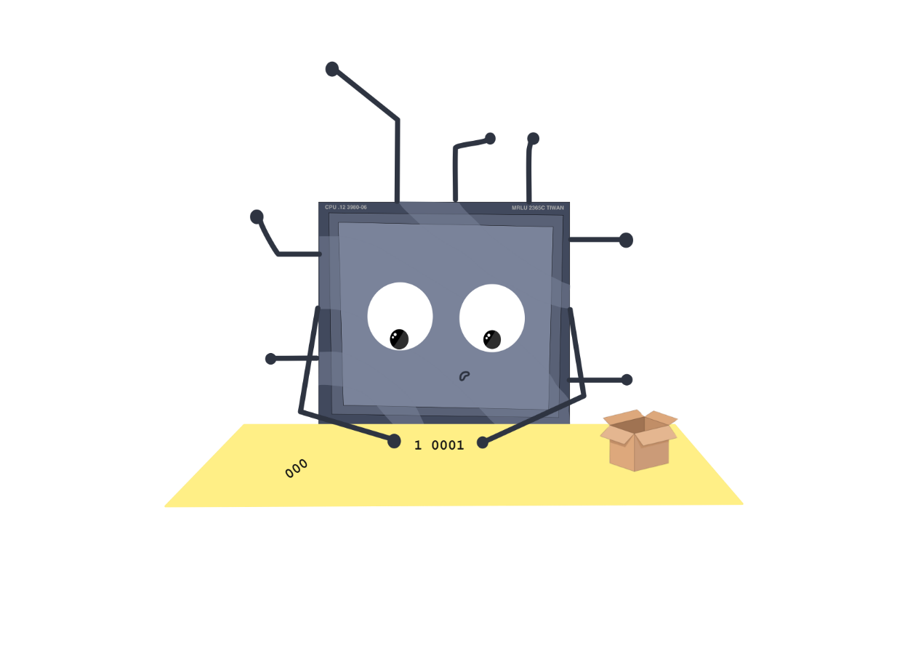
BCD and ASCII Conversion
ASCII to packed BCD conversion
First convert to unpacked BCD (remove the upper 3 bits)
Combine every two digits to make a packed BCD
LDR R0, =0x34; ASCII code for ‘4’
LDR R1, =0x35; ASCII code for ‘5’
AND R0, R0, #0xF; R0 = 0000 0100
AND R1, R1, #0xF; R1 = 0000 0101
ORR R2, R0, R1, LSL #4; R2 = 0101 0100

Slide 23
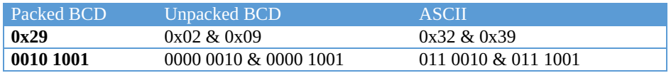
BCD and ASCII Conversion
Packed BCD to ASCII conversion
Convert packed BCD to unpacked BCD
Tagged with 011 0000 (0x30)

Slide 24
Question
In the least significant 8 bits of R0, there are two decimal digits encoded as Packed BCD.
Write a program to decode and put these two digits in R1 and R2. If these two digits form a single 2-digit integer, compute and put the integer in R3.
Rewrite the above program with at most 5 instructions and without using multiplication instructions.

Slide 25
End of Chapter 3!

